Slide 1
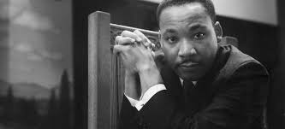

Dr. Martin Luther King, Jr.

Slide 2
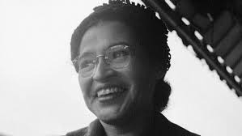
Rosa Parks

Slide 3
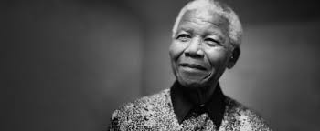
Nelson Mandela

Slide 4
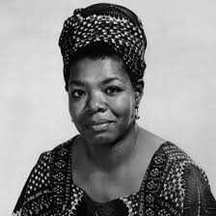
Maya Angelou

Slide 5
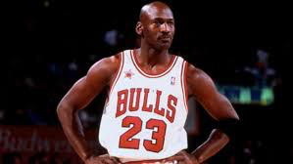
Michael Jordan

Slide 6
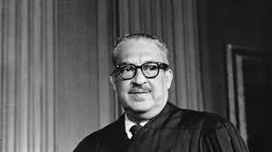
Thurgood Marshall

Slide 7
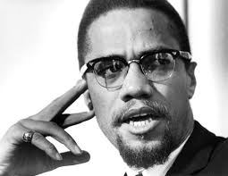
Malcom X

Slide 8
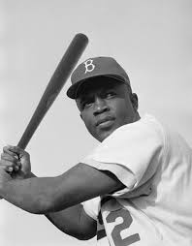
Jackie Robinson

Slide 9
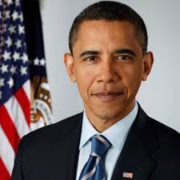
Barack Obama

Slide 10
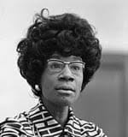
Shirley Chisolm

Slide 11
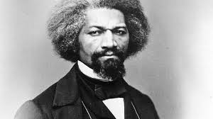
Frederick Douglas

Slide 12
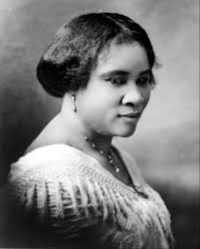
Madam C.J. Walker

Slide 13
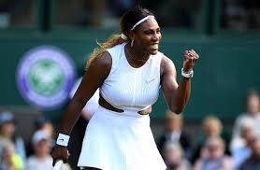
Serena Williams

Slide 14
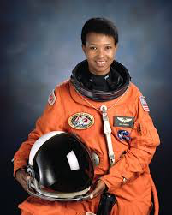
Mae Jemison

Slide 15
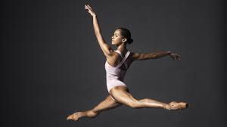
Misty Copeland

Slide 16
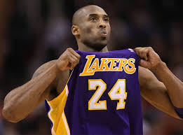
Kobe Bryant
RIP Mamba

Slide 17
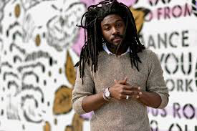
Jason Reynolds

Slide 18
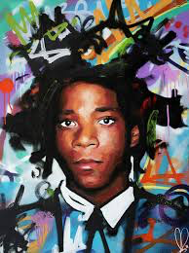

Slide 19
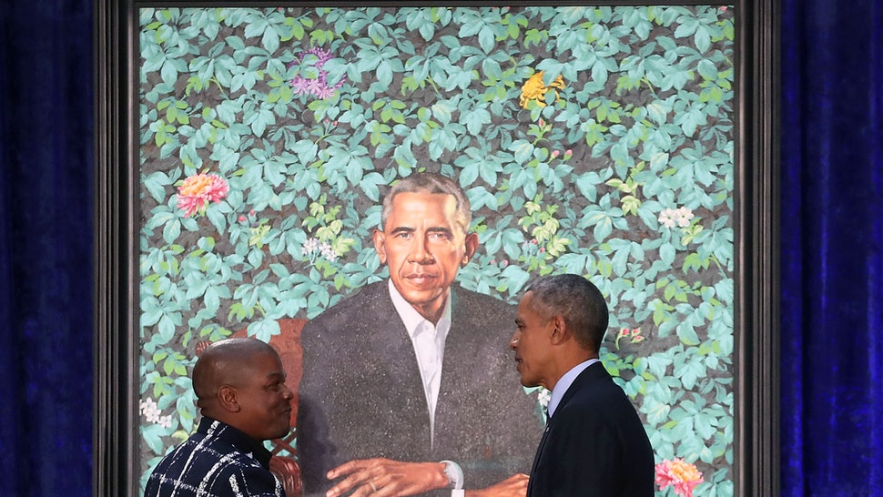

Slide 20
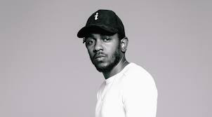
Kendrick Lamar

Slide 21
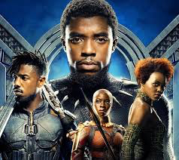
Black Panther

Slide 22
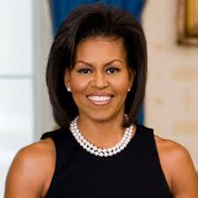
Michelle Obama

Slide 23
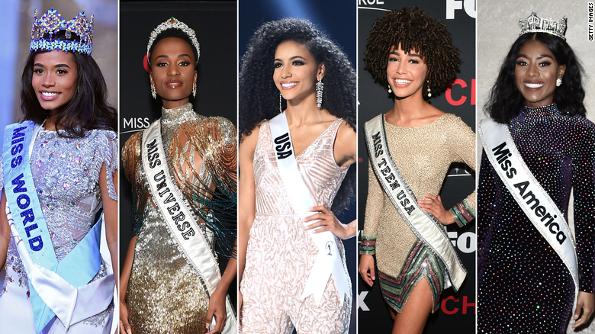
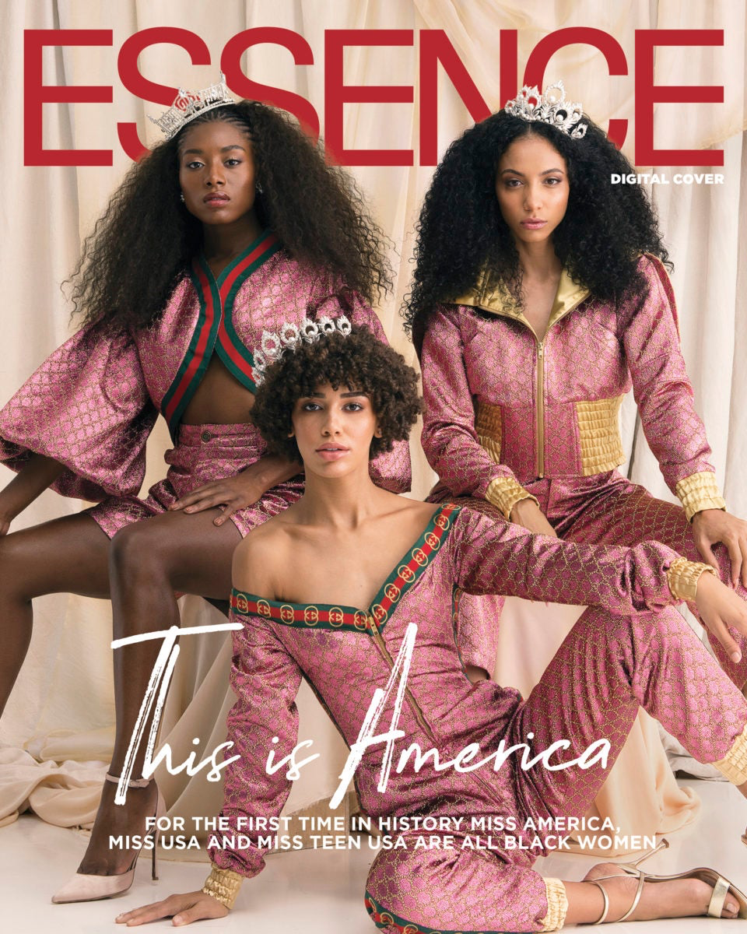
Miss America: Nia Franklin
Miss USA: Chelsie Kryst
Miss Teen USA: Kaliegh Garris
Miss Universe: Zozibini Tunzi
Miss World: Toni-Ann Singh

Slide 24
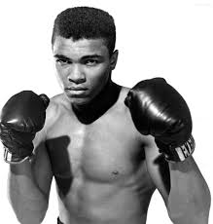
Muhammad Ali

Slide 25
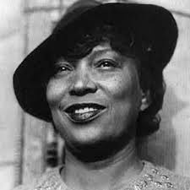
Zora Neale Hurston

